Slide 1
The role of RE Policies Safiatou Alzouma Nouhou IRENA Tanzania RRA Workshop, 9 March 2016

Slide 2
Foundations of a policy framework
Renewable energy policies remain the most important driver of deployment.
While the choice of policy varies depending on specific market conditions, an enabling policy framework should cover at least the following key elements:
Long-term government commitment, and credible short, medium and long term targets.
Smart remuneration arrangements which recognize the capital intensive nature of the renewables by providing long term predictable revenue streams.
Overall stability and predictability, with built in flexibility to allow adaptation.
Actions to tackle non-economic barriers including streamlining planning and permitting, developing the necessary skills base and providing public information.

Slide 3
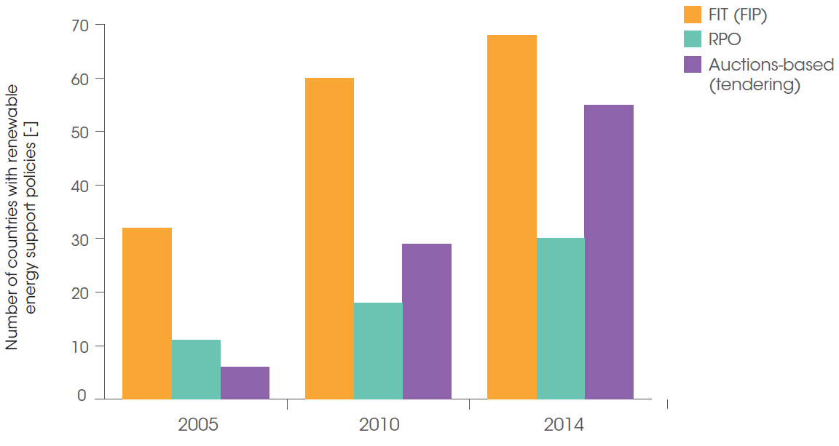
Trends in policy
Number of countries with renewable energy policies, by type
Rise in the adoption of auction (or tendering) schemes to mostly support large-scale renewable energy development

Slide 4
Factors influencing choice of policy instruments
A number of factors influence the choice of policy instruments:
Maturity of power sector: Current mechanism of capacity procurement, availability of IPPs, state of financing for energy sector.
Flexibility: Giving governments the flexibility to incorporate learning by doing and adapt policies, regulations, processes and/or targets.
Price discovery: Closely tracking decreasing cost of deployment to maximise efficiency and effectiveness of support.
Greater certainty regarding price and quantity: Aligning deployment with financial resource availability and infrastructure development.
Market segment: Scale of deployment ranging from small-scale off-grid to roof-top and utility-size development.

Slide 5
Expectations from policies in supporting project development
Generator
kWh
Off-taker/Buyer
kWh
End-user
$$
$$
$$$
$$
Financier
Renewable energy policies are required to:
Ensure long-term certainty in cash-flows for the generators
Reduce uncertainties and transaction costs
Standardize procedures
Increase participation of IPPs (where possible)
Support the building of a track record of projects to attract more financing
De-risk electricity or financial transactions (e.g. b/w off-taker and generator or financier and generator)

Slide 6
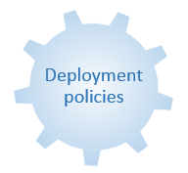
Feed-in tariffs
Most widely used policy instrument to support the development of renewable energy.
Provides maximum levels of certainty in terms of project revenues from electricity generation.
Reduces usually transaction costs and administrative processes given that tariffs are fixed.
Drove deployment in “early adopter” countries such as Germany, Italy, Spain and the United Kingdom.
Early challenges associated with unregulated deployment, limited cost tracking leading to over compensation, financial cost and market integration of high shares of renewables.
Several adaptation measures introduced such as automatic degression schemes and caps on volume and costs.
Regulatory Policies
Feed-in tariff
Auctions/Tendering

Slide 7
Feed-in tariffs in Tanzania
100kW - 10MW threshold for FiT (hydro and biomass only)
Guarantee up to 25years

Slide 8
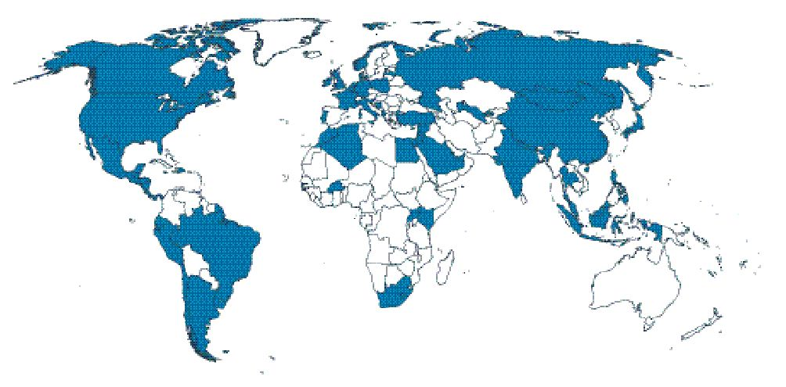
Auctions/Tendering
Auctions have increasingly been adopted to support renewable energy deployment
Based on REN21 Global Status Report (2005 to 2015)
2013
2014
2015

Slide 9
Auctions/Tendering
Strengths and weaknesses of Auctions
Strengths
Flexibility
Real price discovery
Greater certainty regarding prices and quantities
Commitments and transparency
Relatively high transaction costs
Risk of underbuilding and delays
Weaknesses

Slide 10
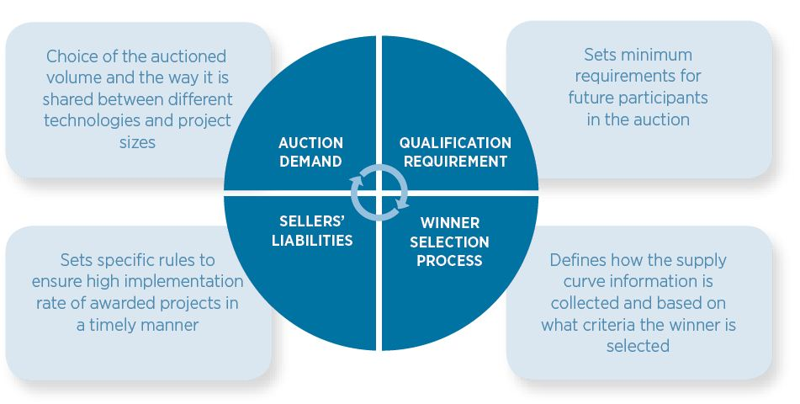
Auctions/Tendering
Design elements

Slide 11
Policy and regulatory frameworks for off-grid RE
Integrating off-grid RE into the national rural electrification strategy supported by dedicated policies relevant to the sector
Stable policy frameworks
Several rural electrification programmes have succeeded after years of learning and course correction
Policies need to as dynamic as the market they set out to support
Effective sector regulation
Encouraging innovation in technology design, financing and business models that reduce costs and improve efficiency
Flexible tariff-setting for mini-grid projects to allow commercial viability
Cooperation and coordination
Between national and international (public, financing, research, etc.) institutions involved in rural electrification
Between different sectors (health, agriculture, etc.)

Slide 12
An integrated policy framework

Slide 13
An Integrated Policy Framework
Research and innovation
Education
and
training
Strengthening firm-level capabilities
Deployment policies
Local content requirements
Investment promotion and technology transfer

Slide 14
Key policy recommendations
Tailored policy mix adapted to country conditions and market segments (large-scale, small-scale and off-grid)
Long-term strategy with clear targets
Stable, predictable and adaptable policy framework
Forward-looking skills, education and training policies
Higher degree of institutional development and coordination

Slide 15
Thank you

