Slide 1
Renewable Energy Resource Assessment and Planning Tijana Radojičić IRENA – Country Support and Partnerships Dar es Salaam, 9 March 2016

Slide 2
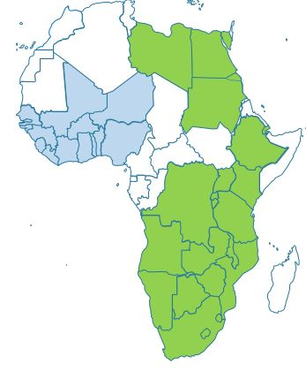
Africa Clean Energy Corridor (ACEC)
Develop RE resources and integrate renewable power into grid
Promote cross-border trade of renewable power
Build on PIDA as well as SAPP and EAPP work (WAPP from now on)
SAPP and
EAPP
WAPP

Slide 3
ACEC Action Agenda
Zoning and Resource Assessment
Identification of high resource zones for RE development.
Country and Regional Planning
Consideration of cost-effective RE options for power generation in national and regional plans.
Enabling Frameworks for Investment
Opening markets to IPPs, reducing the costs of RE financing and facilitating power trade.
Capacity Building
Development of skills to build, plan, operate, power grids with higher RE shares.
Public Information
Awareness raising and promotion of the ACEC and its benefit.

Slide 4
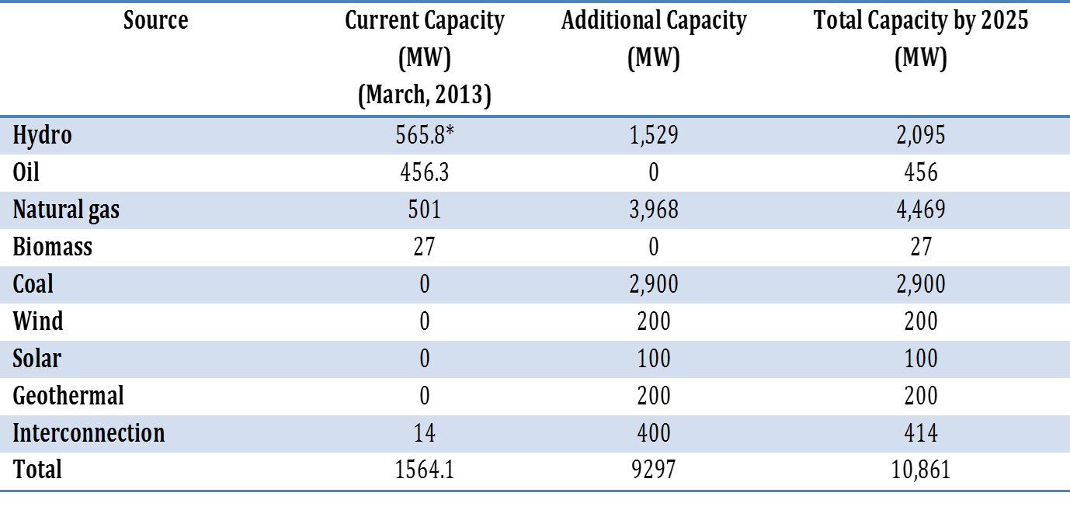

Slide 5
Renewable Energy Zoning
Spatial analysis of renewable energy resources
taking several criteria into account
to identify cost effective, realistically achievable RE resource development zones/project opportunity areas.
Objectives
Identify high-potential renewable energy zones for development.
Facilitate coordinated planning for development of RE resources.
Scope of the Study
Wind, solar PV, and solar CSP
Eastern and Southern African Power Pool countries.

Slide 6
Overview of RE Zoning process
THRESHOLD EXCLUSION CRITERIA:
Resource quality (e.g. <250 W/m²)
Elevation (e.g. >2500m)
Slope (e.g. > 5%)
Protected areas
Water bodies, airports, railroads etc.
Population density (e.g. >100/km²)
Land-use, land-cover.
Distance to existing/planned grid
Distance to road, substation
Distance to RE projects
etc.

Slide 7
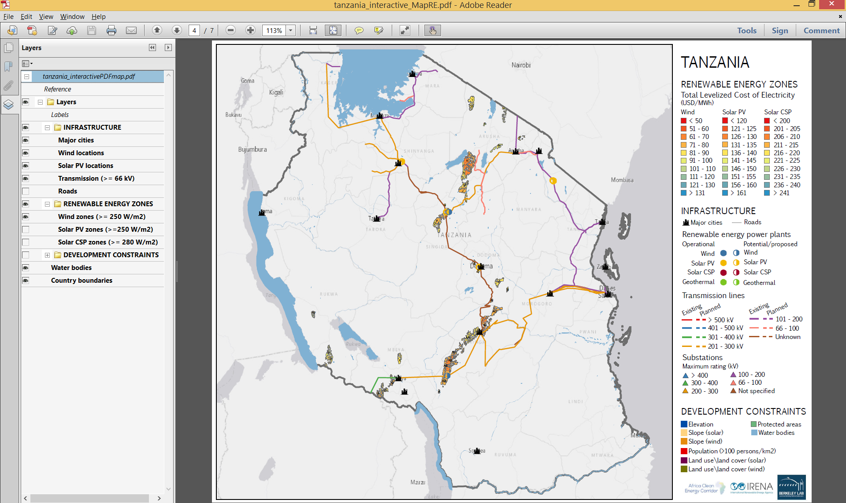
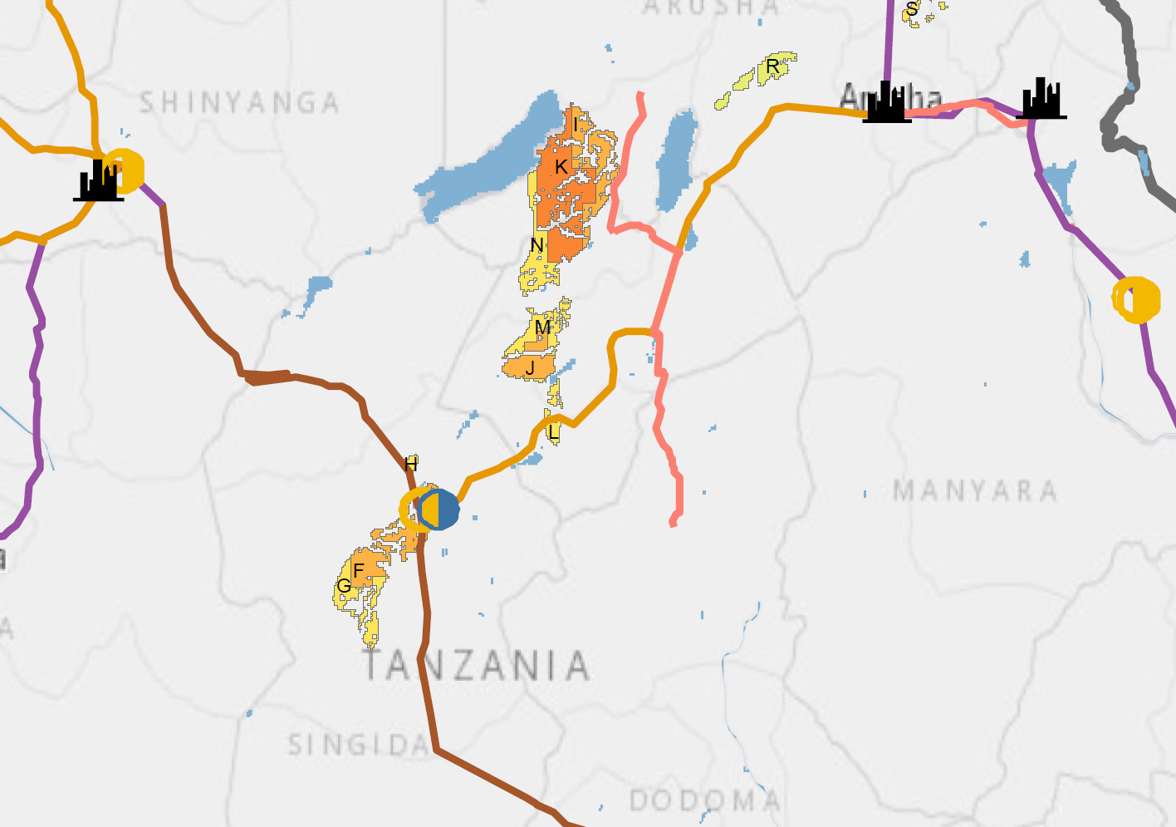
Interactive Zoning Map

Slide 8
Interactive Zoning Map

Slide 9
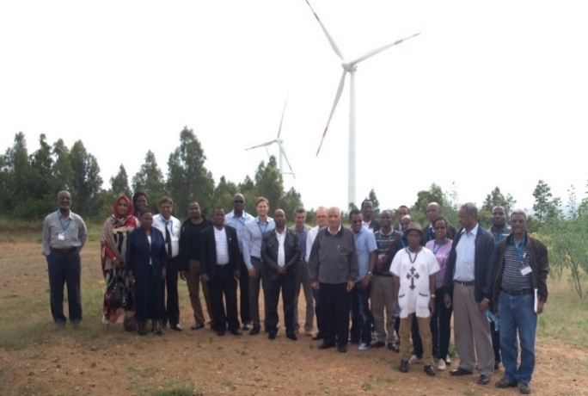
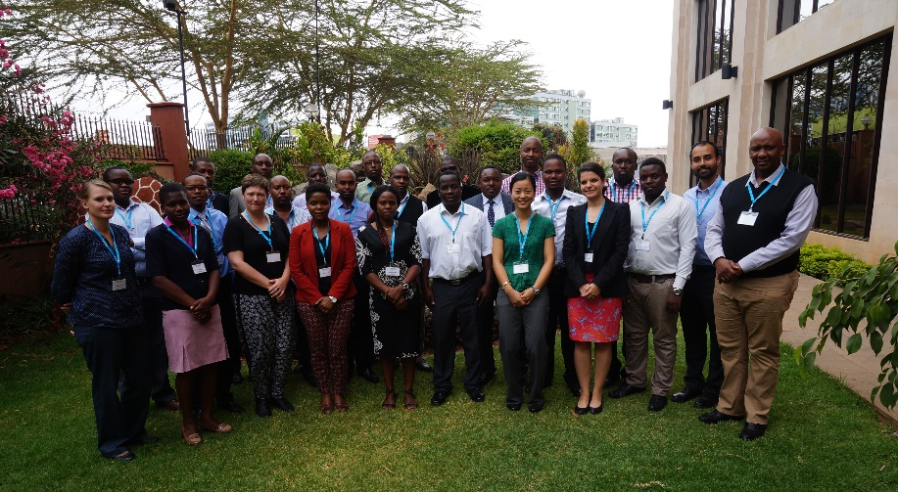
Capacity Building
Addis Ababa - September 2014
With EAPP
Attendees from Tanzania:
TANESCO – Florence Gwang’ombe
University of Dar es Salaam – Michael John Mvungi
Nairobi - September 2015
With Ministry of Energy and Petroleum Kenya
Attendees from Tanzania:
REA - Hussein Shamdas

Slide 10
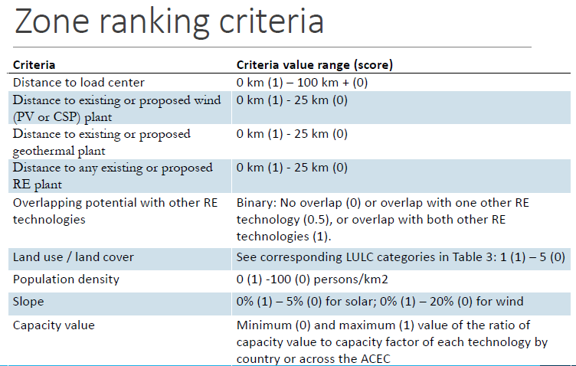
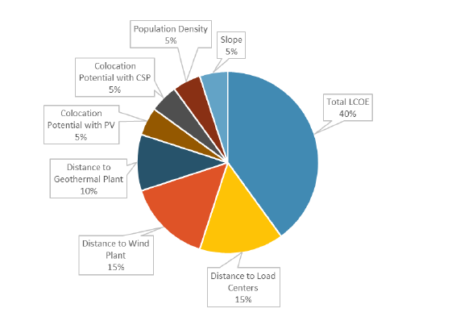

Slide 11
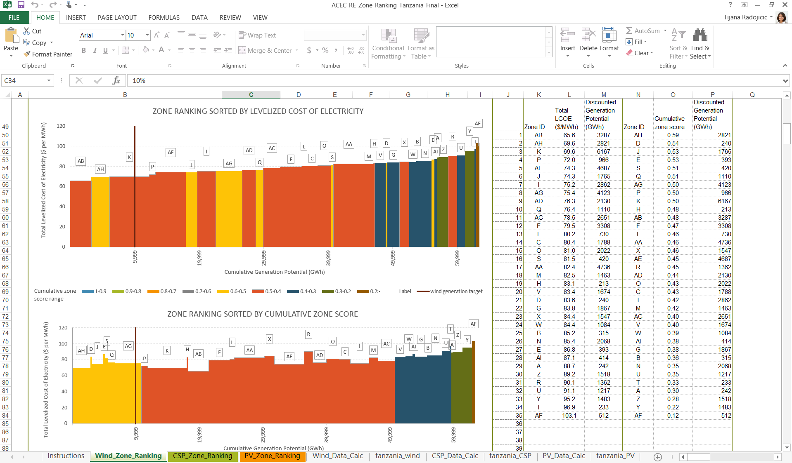
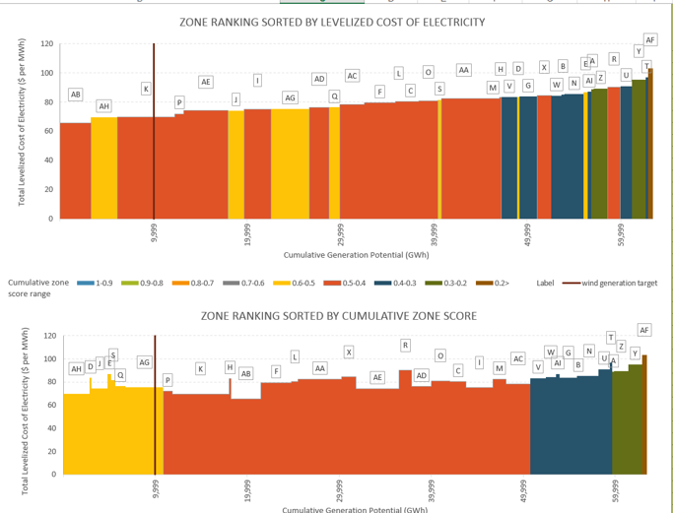
Zone ranking

Slide 12
Estimated RE economic potential in Tanzania
Technology | GW
Wind | 7.0
Solar CSP | 4.4
Solar PV | 13.3
Planned capacity additions
Source | Current Capacity (MW) (March, 2013) | Additional Capacity (MW) | Total Capacity by 2025 (MW)
Hydro | 565.8* | 1,529 | 2,095
Oil | 456.3 | 0 | 456
Natural gas | 501 | 3,968 | 4,469
Biomass | 27 | 0 | 27
Coal | 0 | 2,900 | 2,900
Wind | 0 | 200 | 200
Solar | 0 | 100 | 100
Geothermal | 0 | 200 | 200
Interconnection | 14 | 400 | 414
Total | 1564.1 | 9297 | 10,861

Slide 13
Levelised Cost of Electricity (LCOE)
Technology | LCOE range (c/kWh)
Wind | 6.5 – 10.0
Solar CSP | 21.4 – 22.0
Solar PV | 11.8 – 14.0

Slide 14
Starting point for planning
Understanding the future energy needs and options based on:
Sound statistics and data
Transparent methodology
Ownership of the planning skill

Slide 15
What do you do with it?
Long-term planning, including:
Develop long-term master plans (power sector)
Evaluate policy options
Set targets
Identify and prioritize projects
Analyze policy impacts
Assess financial needs

Slide 16
Typical questions
Assessment of prospects and robustness
What is the least-cost investment path to supply the growing demand?
What are the economic and environmental consequences?
What are the impacts of external factors (e.g. oil price) on investment path
What are the impacts of delay in certain projects (e.g. large hydro)?
Assessment of policy impacts
What is the least-cost investment path to achieve specified policy goals (e.g. RE penetration target, import dependency, affordability, CO2 target)
What is the impacts of investment in international transmission lines on RE deployment

Slide 17
Planned Renewable Energy Projects
Project | Technology | Capacity | Status
Geothermal Phase 1 | Geothermal | 100 MW
Geothermal Phase 2 | Geothermal | 100 MW
Geo Wind Singida | Wind | 50 MW | No sovereign guarantee from Gov.
Wind East Africa Singida | Wind | 100 MW | Announced/planning begun
Makambako Wind Farm | Wind | 100 MW | Expected commissioning 2012, no PPA from TANESCO?
Good PM Singida Phase 2 | Wind | 1,8 GW | Announced in 2009
Nextgen Shinyanga | Solar PV | 60 MW | Announced Sept 2015. Feasibility study underway?
Hecate Dodoma | Solar PV | 55MW | To be operational in 2017. 2MW already started

Slide 18
Thank you!!
To view and download RE zones maps: mapre.lbl.gov

