Slide 1
South East Europe Regional Consultation Meeting Bucharest, Romania 6 – 7 October 2016
Overview on Renewable energy in Bulgaria

Slide 2
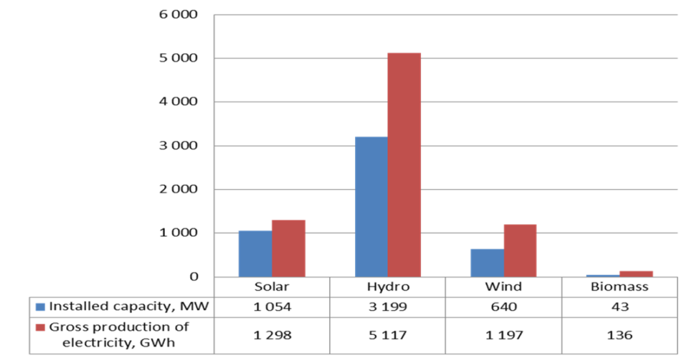
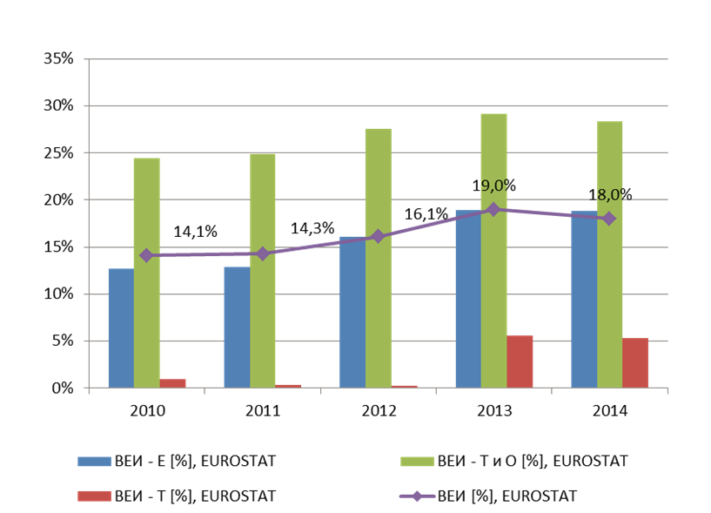
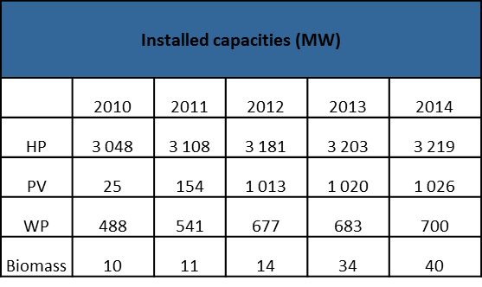
Status of RE development in Bulgaria
Targets by sectors and national binding target of 16% share of energy from renewable sources in gross final energy consumption
Gross production of electricity from renewable sources and installed capacity in 2014

Slide 3
Status of RE development in Bulgaria
Promotion of production of RES electricity by Energy from renewable sources act (ERSA)
Providing guaranteed access of electricity produced from renewable sources to the transmission and distribution electricity grids
Guaranteeing the transmission and distribution of electricity produced from renewable sources
Ensuring the construction of the necessary infrastructure and electricity capacities for the purposes of regulation of the electricity system
Setting as a priority the dispatching of electricity produced from renewable sources
Purchasing of electricity produced from RE at feed-in tariffs and under long-term contracts
According the ERSA the achievement of national target is a ground for encouragements for energy projects for the production of electricity from renewable sources at feed-in tariffs and long-term contracts to be revoked;
Exceptions: Energy installations - ≤ 30 kW on roof and facade constructions of buildings connected to the power distribution network.

Slide 4
Encountered challenges in deploying RE
Legal challenges
Technical challenges
To achieve full liberalization in the energy sector is the choice of mechanism for integration of renewables in the electricity market in the country.
Economic challenges
The purchase of large amounts of electricity from RЕS at preferential prices has had serious adverse social and economic consequences, which prompted the implementation of a number of legislative and regulatory measures;
Grid reinforcement for better RES integration.
Additional transmission and distribution network capabilities;
Storage options also present a potential for short-term flexibility.
Political challenges
Choice of mechanism for integration of renewables in the electricity market in the country

Slide 5
Identified opportunities from the uptake of renewables
Achievement of sustainable and competitive energy policy and economic growth through innovations;
Achievement of sustainable development at regional and local level;
Raising the competitiveness of the small and medium enterprises through production and consumption of RE;
Security of energy supply, delivery and technical safety;
Protection of environment and restricting the climate change;
Raising the life standard of population through economically effective use of energy from renewable sources.

Slide 6
Expected future developments in the frameworks for renewables
New RE target? – forthcoming
New/revised support scheme? – forthcoming
New/revised National Renewable Energy Action Plan?
- No
- Forthcoming elaboration of Climate and Energy Action Plan
New/revised long-term energy strategy? - No

Slide 7
Potential areas of required support
Achievement of requirements concerning policy framework for climate and energy in the period from 2020 to 2030
Achievement of requirements of ILUC Directive

