Slide 1
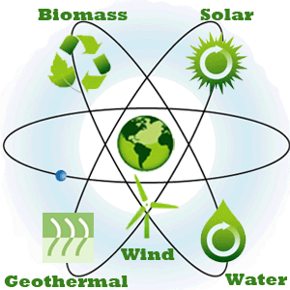
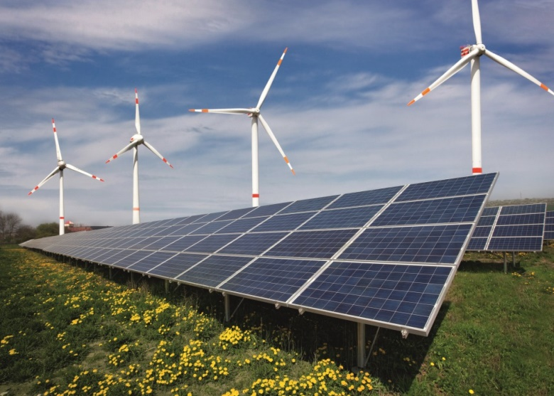
Socio-Economic Benefits of Renewable Energy
Elena POPESCU,
General Director, Ministry of Energy
October 7th, 2016

Slide 2
European and international context
2030 Energy and Climate Change targets
40% cuts in greenhouse gas emissions
The way forward:
The Energy Union
Energy security, solidarity and trust
Paris Climate Agreement – limit global warming to below 2ºC
“Low-carbon technologies” which include large hydro, nuclear and renewable (including wind, solar, geothermal, and other zero-emission sources of power)
EU level target of at least 27% of renewable energy
27% improvement in Energy Efficiency
A fully integrated internal energy market
Energy efficiency
Transition to a long-lasting low-carbon society
An Energy Union for Research, Innovation and Competiveness
“New renewable energy technologies” which include only wind, solar, geothermal, and other zero emission power sources

Slide 3
Challenges of current market designs
The Current Situation
Current electricity wholesale markets do not provide the appropriate long-term investment incentives for low carbon technologies such as:
Hydro
Wind
Solar
Nuclear
Forcing low-carbon investments in such markets would require very high CO2 prices and could entail serious risks to the security of electricity supply
The way forward
Ensuring low-carbon investment in electricity requires new arrangements for appropriate long-term investment signals as well as a robust CO2 price
Different technologies will play different roles
Nuclear and hydro, for instance, are dispatchable
Wind and solar are not dispatchable
The system effects of each technology need to be appropriately taken into account and costs fairly allocated

Slide 4
The structure of the gross production (2015)

Slide 5
The strengths promoted
Ensure energy security of Romania for a minimum cost
A neutral approach from the point of view of technology with reduced carbon footprint and internalize externalities in the cost of producing electricity for all energy technologies;
Choosing the optimal energy mix based on existing resources
Hydro
Coal
Natural gas
Uranium
Increase the share of renewable energy, together with grid reinforcement and smart grid development
Decarbonisation in the production sector but at an affordble cost
The choice of technologies that bring added value to economic growth and employment
Maintaining economic competitiveness

Slide 6
The available installed capacities 2010-2014 – wind

Slide 7
The available installed capacities 2010-2014 solar

Slide 8
RES development – priority versus challenges
At the end of 2011, Romania has exceeded its first interim national target set for 2011 and 2012 - 19% of energy from renewable sources in gross final consumption of energy, achieving a level of 23.6%
This level is almost equal to the national target assumed by Romania and established through Directive 2009/28/EC for 2020 – 24%
Challenges:
Development of RES much quicker than anticipated –overgenerous initial grant of GCs
Higher cost to consumers
Various measures taken to mitigate effect but these often applied to existing projects
Not enough money in the system:
- Either generators lose out on funding
- Or consumers lose out in higher prices
Problem is therefore about sharing the shortfall : between producers/consumers

Slide 9
Profitability of producers versus Affordability for consumers
Real issue:
- Wholesale price is significant element in GC investment profitability
- introduce an uncertainty in the investment model
- Higher wholesale price = better RES return but negative result on consumer affordability –regardless of GC cost
- Increase quota of RES = increase cost
Affordability determined by:
- Consumer income
- Cost of other elements of electricity price (wholesale price, tax, etc.)
Affordability affects:
- Average consumer
- Poorest consumer
- Industrial competitiveness
Regulatory changes already made: adaptation or replacement?

Slide 10
Clean energy has a cost - bridging the gap between costs and benefits Energy production typically results in direct and indirect costs to the producer and to the society:
Cost structure:
Social costs
Private costs
Benefit:
Social benefit
Private benefit
Main components:
- Pollution (e.g. air and water pollution)
Operating costs (fuel)
Investment costs
Main components:
Environmental benefits, improved standard of living
Revenue from selling energy

Slide 11
Positive Overall Economic Effects
Reduction of fossil energy import
Less dependency upon foreign energy supply
Less price volatility
Energy security
Improvement of electrical energy supply, especially for rural areas;
Remote regions without grid access:
Improvements of standard of living and chances for business opportunities through supply of electricity
Costs savings in new grid and high voltage transmission lines investments

Slide 12
Address sensitivities of SEE
SEE specificities: vulnerabilities, economic gap with NW Europe
Evaluate real potential for development of RES;
Analyse the whole electricity system and infrastructure and develop in coordination with the enforcement of the grid – security of grid;
Take into consideration affordability of the consumer; a very ambitious target for a low economic developed country could result into failure of the whole energy system;
Take into consideration the transition towards the high RES quota when it is steel need for fosil sources; we can not afford to eliminate coal and nuclear (for countries reling on nuclear) until full deploiment of efficient, afordable, reliable RES and electricity storage;
Give clear signal to investors; there is a need for investment in all areas of energy system; single RES can not solve our energy needs;
Consider the economic stability on implementing the specific legislation : base legislation on independent impact studies;
Technology transfer.

Slide 13
Elena POPESCU,
General Director, Ministry of Energy
Contact:
E-mail: elena.popescu@energie.gov.ro
Tel: +4021 4079932
Address: Splaiul Independentei, 202E, Bucharest, Romania
www.energie.gov.ro

